Slide 1
UX Performance TEST DOCUMENT
This document is used purely for performance testing in applications such as MS PowerPoint. It contains nothing of interest or substance.

Slide 2
Overview
Cras vel massa condimentum nisi ultricies venenatis at id nibh. Fusce et risus eget neque scelerisque vestibulum. In vestibulum arcu eget risus congue congue.
Sed sagittis massa eu risus pretium molestie tempor elit cursus. Pellentesque sodales, diam sit amet laoreet vehicula, neque neque consectetur leo, quis hendrerit purus quam eget nisi. Quisque non vestibulum sem.
Ut eget lacus id felis pellentesque rutrum. In hendrerit lacinia tempus. Aenean in odio id mauris dapibus ultrices at in arcu. Phasellus id augue metus. Ut porttitor arcu in nulla suscipit facilisis viverra leo posuere.
Phasellus et felis leo. Suspendisse est metus, interdum quis laoreet vel, laoreet a quam. Sed faucibus, dui in mattis hendrerit, quam nulla dictum enim, ac vulputate urna libero sit amet augue.

Slide 3
Activities
Objectives
Adaptations
Pellentesque aliquam viverra felis, commodo mollis odio aliquet sit amet. Aliquam lobortis leo id lectus vulputate ut vehicula neque malesuada.
Fusce ac dictum ligula. Sed vel orci nec orci vestibulum euismod vel sed augue. Fusce posuere, dolor cursus tincidunt posuere, urna magna hendrerit nibh, vel malesuada lorem quam et nibh. Aliquam erat volutpat.

Slide 5
Table
1 | 2 | 3 | 4 | 5 | 6 | 7 | 8 | 9 | 10
Blah | Blah | Blah | Blah | Blah | Blah | Blah | Blah | Blah | Blah
Blah | Blah | Blah | Blah | Blah | Blah | Blah | Blah | Blah | Blah
Blah | Blah | Blah | Blah | Blah | Blah | Blah | Blah | Blah | Blah
Blah | Blah | Blah | Blah | Blah | Blah | Blah | Blah | Blah | Blah
Blah | Blah | Blah | Blah | Blah | Blah | Blah | Blah | Blah | Blah
Blah | Blah | Blah | Blah | Blah | Blah | Blah | Blah | Blah | Blah
Blah | Blah | Blah | Blah | Blah | Blah | Blah | Blah | Blah | Blah
Blah | Blah | Blah | Blah | Blah | Blah | Blah | Blah | Blah | Blah
Blah | Blah | Blah | Blah | Blah | Blah | Blah | Blah | Blah | Blah

Slide 6
The quick brown fox jumps over the lazy dog. The quick brown fox jumps over the lazy dog. The quick brown fox jumps over the lazy dog. The quick brown fox jumps over the lazy dog. The quick brown fox jumps over the lazy dog. The quick brown fox jumps over the lazy dog. The quick brown fox jumps over the lazy dog. The quick brown fox jumps over the lazy dog. The quick brown fox jumps over the lazy dog. The quick brown fox jumps over the lazy dog.
The quick brown fox jumps over the lazy dog. The quick brown fox jumps over the lazy dog. The quick brown fox jumps over the lazy dog. The quick brown fox jumps over the lazy dog. The quick brown fox jumps over the lazy dog. The quick brown fox jumps over the lazy dog. The quick brown fox jumps over the lazy dog. The quick brown fox jumps over the lazy dog. The quick brown fox jumps over the lazy dog. The quick brown fox jumps over the lazy dog.
The quick brown fox jumps over the lazy dog. The quick brown fox jumps over the lazy dog. The quick brown fox jumps over the lazy dog. The quick brown fox jumps over the lazy dog. The quick brown fox jumps over the lazy dog. The quick brown fox jumps over the lazy dog. The quick brown fox jumps over the lazy dog. The quick brown fox jumps over the lazy dog. The quick brown fox jumps over the lazy dog. The quick brown fox jumps over the lazy dog.
The quick brown fox jumps over the lazy dog. The quick brown fox jumps over the lazy dog. The quick brown fox jumps over the lazy dog. The quick brown fox jumps over the lazy dog. The quick brown fox jumps over the lazy dog. The quick brown fox jumps over the lazy dog. The quick brown fox jumps over the lazy dog. The quick brown fox jumps over the lazy dog. The quick brown fox jumps over the lazy dog. The quick brown fox jumps over the lazy dog.

Slide 7
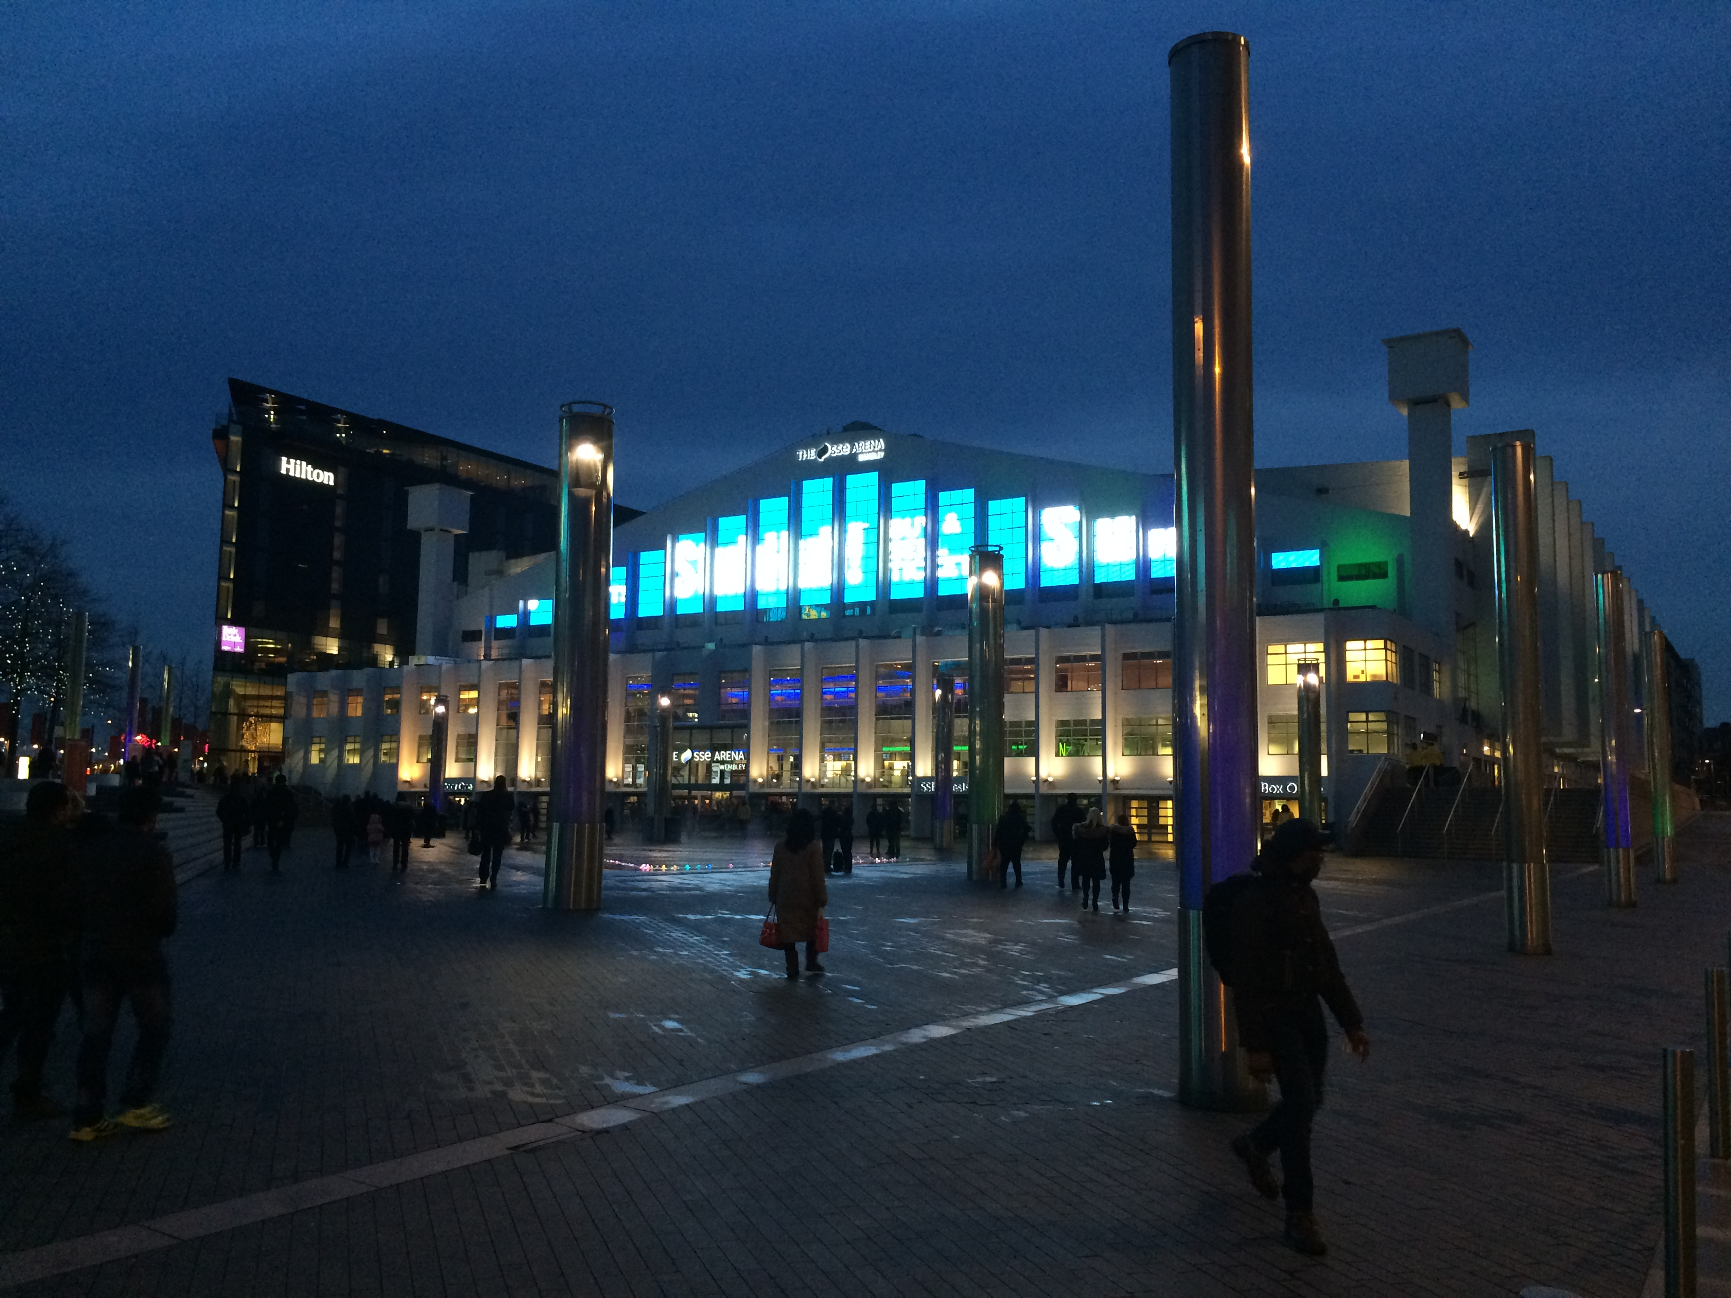

Slide 8
The quick brown fox jumps over the lazy dog. The quick brown fox jumps over the lazy dog. The quick brown fox jumps over the lazy dog. The quick brown fox jumps over the lazy dog. The quick brown fox jumps over the lazy dog. The quick brown fox jumps over the lazy dog. The quick brown fox jumps over the lazy dog. The quick brown fox jumps over the lazy dog. The quick brown fox jumps over the lazy dog. The quick brown fox jumps over the lazy dog.
The quick brown fox jumps over the lazy dog. The quick brown fox jumps over the lazy dog. The quick brown fox jumps over the lazy dog. The quick brown fox jumps over the lazy dog. The quick brown fox jumps over the lazy dog. The quick brown fox jumps over the lazy dog. The quick brown fox jumps over the lazy dog. The quick brown fox jumps over the lazy dog. The quick brown fox jumps over the lazy dog. The quick brown fox jumps over the lazy dog.
The quick brown fox jumps over the lazy dog. The quick brown fox jumps over the lazy dog. The quick brown fox jumps over the lazy dog. The quick brown fox jumps over the lazy dog. The quick brown fox jumps over the lazy dog. The quick brown fox jumps over the lazy dog. The quick brown fox jumps over the lazy dog. The quick brown fox jumps over the lazy dog. The quick brown fox jumps over the lazy dog. The quick brown fox jumps over the lazy dog.
The quick brown fox jumps over the lazy dog. The quick brown fox jumps over the lazy dog. The quick brown fox jumps over the lazy dog. The quick brown fox jumps over the lazy dog. The quick brown fox jumps over the lazy dog. The quick brown fox jumps over the lazy dog. The quick brown fox jumps over the lazy dog. The quick brown fox jumps over the lazy dog. The quick brown fox jumps over the lazy dog. The quick brown fox jumps over the lazy dog.

Slide 9
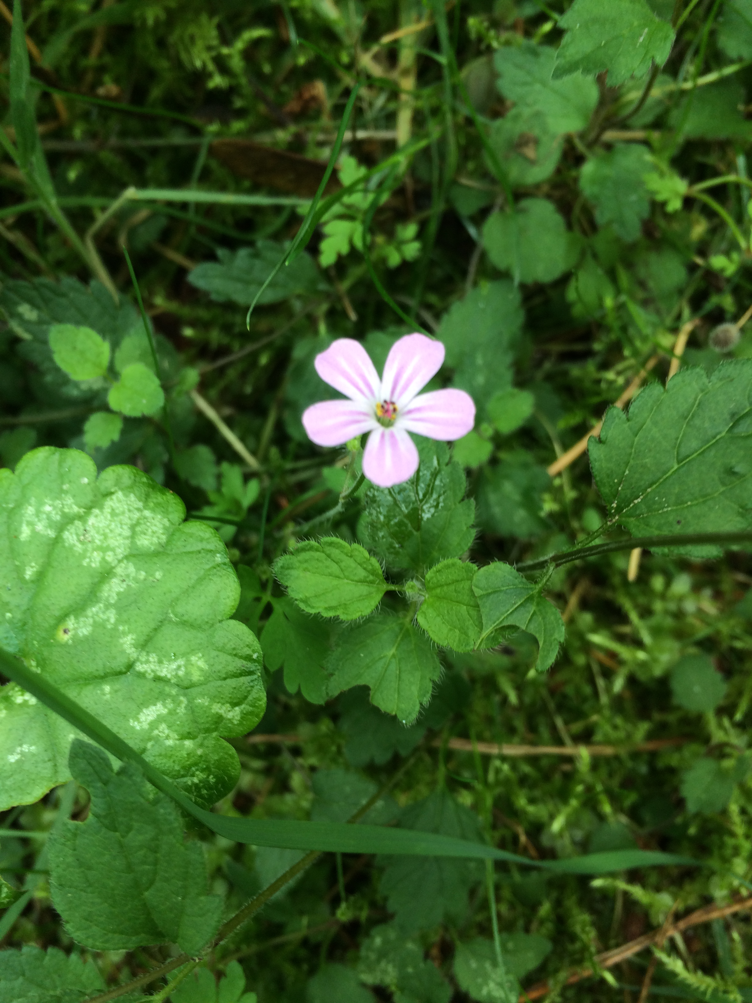

Slide 10
The quick brown fox jumps over the lazy dog. The quick brown fox jumps over the lazy dog. The quick brown fox jumps over the lazy dog. The quick brown fox jumps over the lazy dog. The quick brown fox jumps over the lazy dog. The quick brown fox jumps over the lazy dog. The quick brown fox jumps over the lazy dog. The quick brown fox jumps over the lazy dog. The quick brown fox jumps over the lazy dog. The quick brown fox jumps over the lazy dog.
The quick brown fox jumps over the lazy dog. The quick brown fox jumps over the lazy dog. The quick brown fox jumps over the lazy dog. The quick brown fox jumps over the lazy dog. The quick brown fox jumps over the lazy dog. The quick brown fox jumps over the lazy dog. The quick brown fox jumps over the lazy dog. The quick brown fox jumps over the lazy dog. The quick brown fox jumps over the lazy dog. The quick brown fox jumps over the lazy dog.
The quick brown fox jumps over the lazy dog. The quick brown fox jumps over the lazy dog. The quick brown fox jumps over the lazy dog. The quick brown fox jumps over the lazy dog. The quick brown fox jumps over the lazy dog. The quick brown fox jumps over the lazy dog. The quick brown fox jumps over the lazy dog. The quick brown fox jumps over the lazy dog. The quick brown fox jumps over the lazy dog. The quick brown fox jumps over the lazy dog.
The quick brown fox jumps over the lazy dog. The quick brown fox jumps over the lazy dog. The quick brown fox jumps over the lazy dog. The quick brown fox jumps over the lazy dog. The quick brown fox jumps over the lazy dog. The quick brown fox jumps over the lazy dog. The quick brown fox jumps over the lazy dog. The quick brown fox jumps over the lazy dog. The quick brown fox jumps over the lazy dog. The quick brown fox jumps over the lazy dog.

Slide 11

Test Picture with Caption
The quick brow fox jumped over the lazy dog.The quick brow fox jumped over the lazy dog.The quick brow fox jumped over the lazy dog.The quick brow fox jumped over the lazy dog.The quick brow fox jumped over the lazy dog.The quick brow fox jumped over the lazy dog.The quick brow fox jumped over the lazy dog.The quick brow fox jumped over the lazy dog.The quick brow fox jumped over the lazy dog.

Slide 12


Slide 13
The quick brown fox jumps over the lazy dog. The quick brown fox jumps over the lazy dog. The quick brown fox jumps over the lazy dog. The quick brown fox jumps over the lazy dog. The quick brown fox jumps over the lazy dog. The quick brown fox jumps over the lazy dog. The quick brown fox jumps over the lazy dog. The quick brown fox jumps over the lazy dog. The quick brown fox jumps over the lazy dog. The quick brown fox jumps over the lazy dog.
The quick brown fox jumps over the lazy dog. The quick brown fox jumps over the lazy dog. The quick brown fox jumps over the lazy dog. The quick brown fox jumps over the lazy dog. The quick brown fox jumps over the lazy dog. The quick brown fox jumps over the lazy dog. The quick brown fox jumps over the lazy dog. The quick brown fox jumps over the lazy dog. The quick brown fox jumps over the lazy dog. The quick brown fox jumps over the lazy dog.
The quick brown fox jumps over the lazy dog. The quick brown fox jumps over the lazy dog. The quick brown fox jumps over the lazy dog. The quick brown fox jumps over the lazy dog. The quick brown fox jumps over the lazy dog. The quick brown fox jumps over the lazy dog. The quick brown fox jumps over the lazy dog. The quick brown fox jumps over the lazy dog. The quick brown fox jumps over the lazy dog. The quick brown fox jumps over the lazy dog.
The quick brown fox jumps over the lazy dog. The quick brown fox jumps over the lazy dog. The quick brown fox jumps over the lazy dog. The quick brown fox jumps over the lazy dog. The quick brown fox jumps over the lazy dog. The quick brown fox jumps over the lazy dog. The quick brown fox jumps over the lazy dog. The quick brown fox jumps over the lazy dog. The quick brown fox jumps over the lazy dog. The quick brown fox jumps over the lazy dog.

Slide 15
The quick brown fox jumps over the lazy dog. The quick brown fox jumps over the lazy dog. The quick brown fox jumps over the lazy dog. The quick brown fox jumps over the lazy dog. The quick brown fox jumps over the lazy dog. The quick brown fox jumps over the lazy dog. The quick brown fox jumps over the lazy dog. The quick brown fox jumps over the lazy dog. The quick brown fox jumps over the lazy dog. The quick brown fox jumps over the lazy dog.
The quick brown fox jumps over the lazy dog. The quick brown fox jumps over the lazy dog. The quick brown fox jumps over the lazy dog. The quick brown fox jumps over the lazy dog. The quick brown fox jumps over the lazy dog. The quick brown fox jumps over the lazy dog. The quick brown fox jumps over the lazy dog. The quick brown fox jumps over the lazy dog. The quick brown fox jumps over the lazy dog. The quick brown fox jumps over the lazy dog.
The quick brown fox jumps over the lazy dog. The quick brown fox jumps over the lazy dog. The quick brown fox jumps over the lazy dog. The quick brown fox jumps over the lazy dog. The quick brown fox jumps over the lazy dog. The quick brown fox jumps over the lazy dog. The quick brown fox jumps over the lazy dog. The quick brown fox jumps over the lazy dog. The quick brown fox jumps over the lazy dog. The quick brown fox jumps over the lazy dog.
The quick brown fox jumps over the lazy dog. The quick brown fox jumps over the lazy dog. The quick brown fox jumps over the lazy dog. The quick brown fox jumps over the lazy dog. The quick brown fox jumps over the lazy dog. The quick brown fox jumps over the lazy dog. The quick brown fox jumps over the lazy dog. The quick brown fox jumps over the lazy dog. The quick brown fox jumps over the lazy dog. The quick brown fox jumps over the lazy dog.

Slide 16
Table
1 | 2 | 3 | 4 | 5 | 6 | 7 | 8 | 9 | 10
Blah | Blah | Blah | Blah | Blah | Blah | Blah | Blah | Blah | Blah
Blah | Blah | Blah | Blah | Blah | Blah | Blah | Blah | Blah | Blah
Blah | Blah | Blah | Blah | Blah | Blah | Blah | Blah | Blah | Blah
Blah | Blah | Blah | Blah | Blah | Blah | Blah | Blah | Blah | Blah
Blah | Blah | Blah | Blah | Blah | Blah | Blah | Blah | Blah | Blah
Blah | Blah | Blah | Blah | Blah | Blah | Blah | Blah | Blah | Blah
Blah | Blah | Blah | Blah | Blah | Blah | Blah | Blah | Blah | Blah
Blah | Blah | Blah | Blah | Blah | Blah | Blah | Blah | Blah | Blah
Blah | Blah | Blah | Blah | Blah | Blah | Blah | Blah | Blah | Blah

Slide 17
The quick brown fox jumps over the lazy dog. The quick brown fox jumps over the lazy dog. The quick brown fox jumps over the lazy dog. The quick brown fox jumps over the lazy dog. The quick brown fox jumps over the lazy dog. The quick brown fox jumps over the lazy dog. The quick brown fox jumps over the lazy dog. The quick brown fox jumps over the lazy dog. The quick brown fox jumps over the lazy dog. The quick brown fox jumps over the lazy dog.
The quick brown fox jumps over the lazy dog. The quick brown fox jumps over the lazy dog. The quick brown fox jumps over the lazy dog. The quick brown fox jumps over the lazy dog. The quick brown fox jumps over the lazy dog. The quick brown fox jumps over the lazy dog. The quick brown fox jumps over the lazy dog. The quick brown fox jumps over the lazy dog. The quick brown fox jumps over the lazy dog. The quick brown fox jumps over the lazy dog.
The quick brown fox jumps over the lazy dog. The quick brown fox jumps over the lazy dog. The quick brown fox jumps over the lazy dog. The quick brown fox jumps over the lazy dog. The quick brown fox jumps over the lazy dog. The quick brown fox jumps over the lazy dog. The quick brown fox jumps over the lazy dog. The quick brown fox jumps over the lazy dog. The quick brown fox jumps over the lazy dog. The quick brown fox jumps over the lazy dog.
The quick brown fox jumps over the lazy dog. The quick brown fox jumps over the lazy dog. The quick brown fox jumps over the lazy dog. The quick brown fox jumps over the lazy dog. The quick brown fox jumps over the lazy dog. The quick brown fox jumps over the lazy dog. The quick brown fox jumps over the lazy dog. The quick brown fox jumps over the lazy dog. The quick brown fox jumps over the lazy dog. The quick brown fox jumps over the lazy dog.

Slide 18
Test Picture with Caption
The quick brow fox jumped over the lazy dog.The quick brow fox jumped over the lazy dog.The quick brow fox jumped over the lazy dog.The quick brow fox jumped over the lazy dog.The quick brow fox jumped over the lazy dog.The quick brow fox jumped over the lazy dog.The quick brow fox jumped over the lazy dog.The quick brow fox jumped over the lazy dog.The quick brow fox jumped over the lazy dog.

Slide 19
The quick brown fox jumps over the lazy dog. The quick brown fox jumps over the lazy dog. The quick brown fox jumps over the lazy dog. The quick brown fox jumps over the lazy dog. The quick brown fox jumps over the lazy dog. The quick brown fox jumps over the lazy dog. The quick brown fox jumps over the lazy dog. The quick brown fox jumps over the lazy dog. The quick brown fox jumps over the lazy dog. The quick brown fox jumps over the lazy dog.
The quick brown fox jumps over the lazy dog. The quick brown fox jumps over the lazy dog. The quick brown fox jumps over the lazy dog. The quick brown fox jumps over the lazy dog. The quick brown fox jumps over the lazy dog. The quick brown fox jumps over the lazy dog. The quick brown fox jumps over the lazy dog. The quick brown fox jumps over the lazy dog. The quick brown fox jumps over the lazy dog. The quick brown fox jumps over the lazy dog.
The quick brown fox jumps over the lazy dog. The quick brown fox jumps over the lazy dog. The quick brown fox jumps over the lazy dog. The quick brown fox jumps over the lazy dog. The quick brown fox jumps over the lazy dog. The quick brown fox jumps over the lazy dog. The quick brown fox jumps over the lazy dog. The quick brown fox jumps over the lazy dog. The quick brown fox jumps over the lazy dog. The quick brown fox jumps over the lazy dog.
The quick brown fox jumps over the lazy dog. The quick brown fox jumps over the lazy dog. The quick brown fox jumps over the lazy dog. The quick brown fox jumps over the lazy dog. The quick brown fox jumps over the lazy dog. The quick brown fox jumps over the lazy dog. The quick brown fox jumps over the lazy dog. The quick brown fox jumps over the lazy dog. The quick brown fox jumps over the lazy dog. The quick brown fox jumps over the lazy dog.

Slide 20
THE END

